Slide 1



ONLINE
GAMING
PLATFORM
By Ayan Ghosh
Souradeep Dutta

Slide 2
INTRODUCTION
In today's rapidly evolving digital era, maintaining cognitive agility while enjoying oneself is of paramount importance. We've developed an Android application, “Khelo” that offers users a dynamic and captivating online gaming hub centered around quiz games, such as IQ challenges and various mentally stimulating activities.

Slide 3

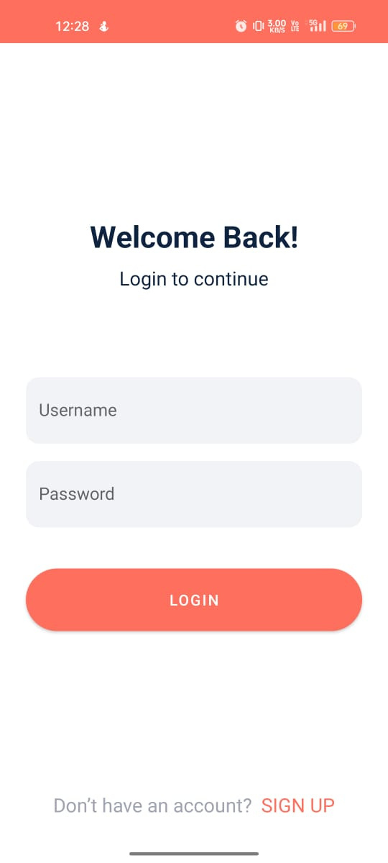
LOGIN PAGE
Our platform offers user registration and authentication features, allowing individuals to create personalized accounts with unique profiles. To ensure the protection of user data, we've implemented secure and robust authentication mechanisms, prioritizing the confidentiality and security of their personal information.

Slide 4
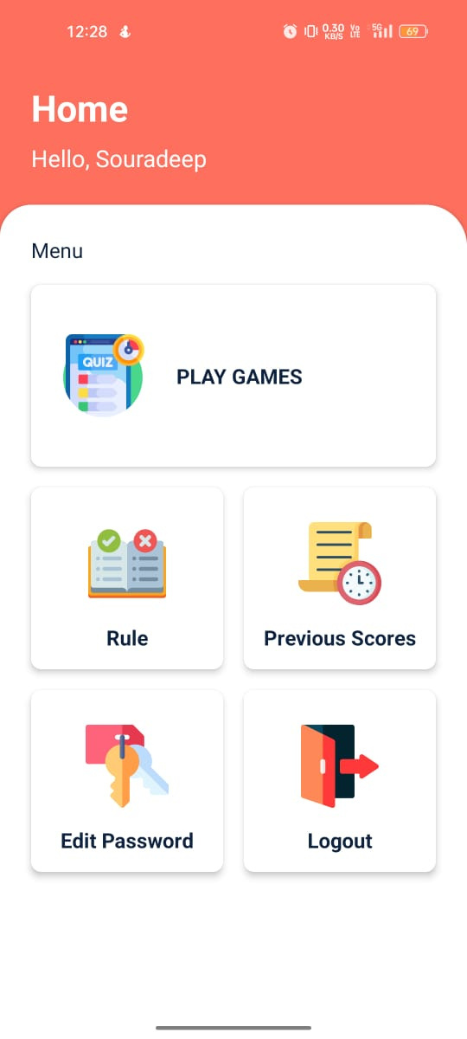
HOME PAGE
After logging in, the app directs users to the home page, which starts by displaying a warm greeting, "Hello, [User's Name].".

Slide 5
OUR HOME PAGE INCLUDES..
EDIT PASSWORD
RULES
PLAY GAMES
Our app features diverse quiz categories, including IQ and word challenges, with the ability to add more over time.
Users have the option to change their password in case they forget it or wish to update it for security reasons.
Implement quiz game rules, scoring, and win/loss conditions
1
2
2

Slide 6

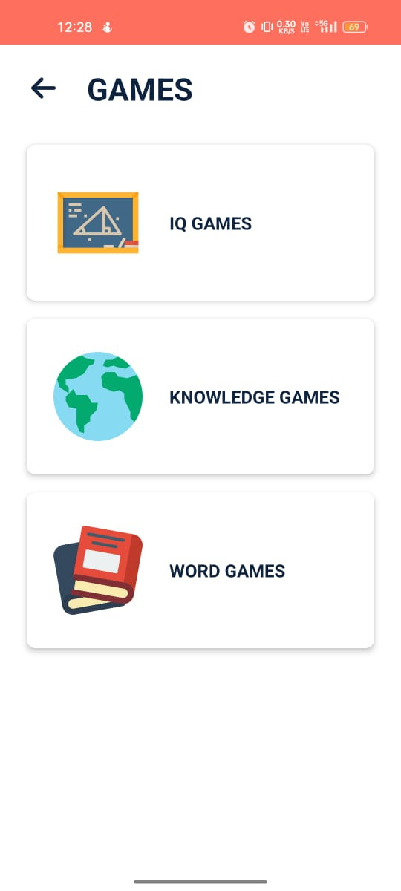

GAMES PAGE
GAMES PAGE
Our app offers a wide array of quiz game categories, encompassing IQ challenges, word challenges, and an array of other exciting options. Furthermore, we've designed the platform with the flexibility to continually expand the selection of quiz categories as we evolve, ensuring a diverse and engaging gaming experience for our users.
After logging in, the app directs users to the home page, which starts by displaying a warm greeting, "Hello, [User's Name].".

Slide 7
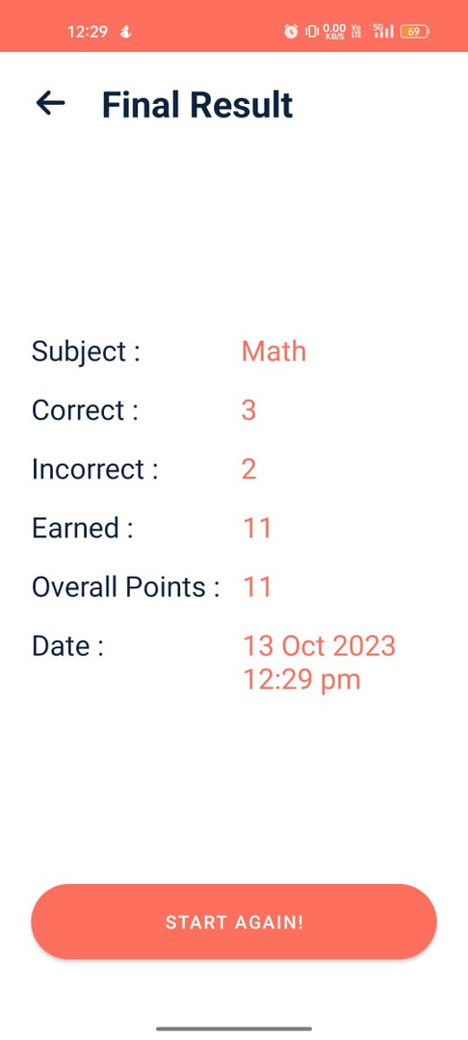


THIS RESULTS WILL BE SHOWN..
Upon completing all the questions, a "Final Result" page will be displayed.

Slide 8
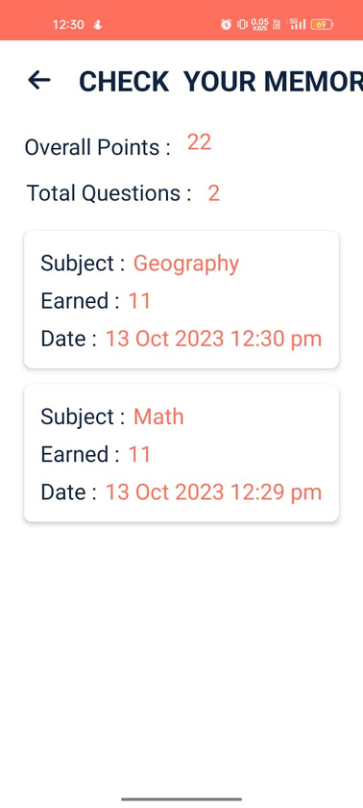
OUR HOME PAGE ALSO INCLUDES..
PREVIOUS SCORES
Establish leaderboards to highlight top players across various categories, incorporating ranking systems that foster healthy competition and player recognition.
3

Slide 9
OUR HOME PAGE ALSO INCLUDES..
PREVIOUS SCORES
LOG-OUT
Establish leaderboards to highlight top players across various categories, incorporating ranking systems that foster healthy competition and player recognition.
To enhance security, users have the capability to log out from their accounts once they've finished playing games.
4
5

Slide 10





TECHNOLOGY USED
Our application is built using the JAVA and XML languages, with data storage managed through the Android SQLite DB. We utilize the Asynctask framework for handling asynchronous tasks and the Room Persistence Library to streamline database operations. These components collectively enable us to provide a robust and efficient user experience within our Android app.

Slide 11

FUTURE ENHANCEMENT
We have a forward-looking strategy for continual improvement, with plans to introduce fresh quiz categories and innovative features. Our approach is driven by user feedback and industry trends, ensuring that our platform evolves in response to the demands and preferences of our users, as well as staying current with the latest developments in the gaming industry.

Slide 12


CONCLUSION
This app transcends being just a gaming platform; it's a gateway to learning, personal growth, and connecting with a worldwide community of quiz aficionados. Whether you seek to challenge friends, showcase your IQ, or simply revel in enjoyment, our app caters to diverse interests and aspirations.

Slide 13



THANK YOU!

